Slide 1
Technical Support Analysis
By
Oleg Makarovskiy

Slide 2
The Problem:
Predict level of customer satisfaction
Notes:
It’s no great discovery that water flows into itself. The issues of one part of the harbor are not entirely isolated from the issues of another. By better understanding how this water quality network works, water quality issues can be treated systematically rather than on a case by case basis.
Understanding the system requires constant and broad monitoring which is costly and time consuming.

Slide 3
The Solution:
Define main features affecting customer satisfaction
Notes:
My proposed solution is to use geospatial statistics, network analysis, and machine learning to reduce monitoring costs without sacrificing accuracy
I looked at Chlorophyll A because it signals harmful algae blooms that can cause cascading effects damaging the natural ecosystem and public health alike

Slide 4
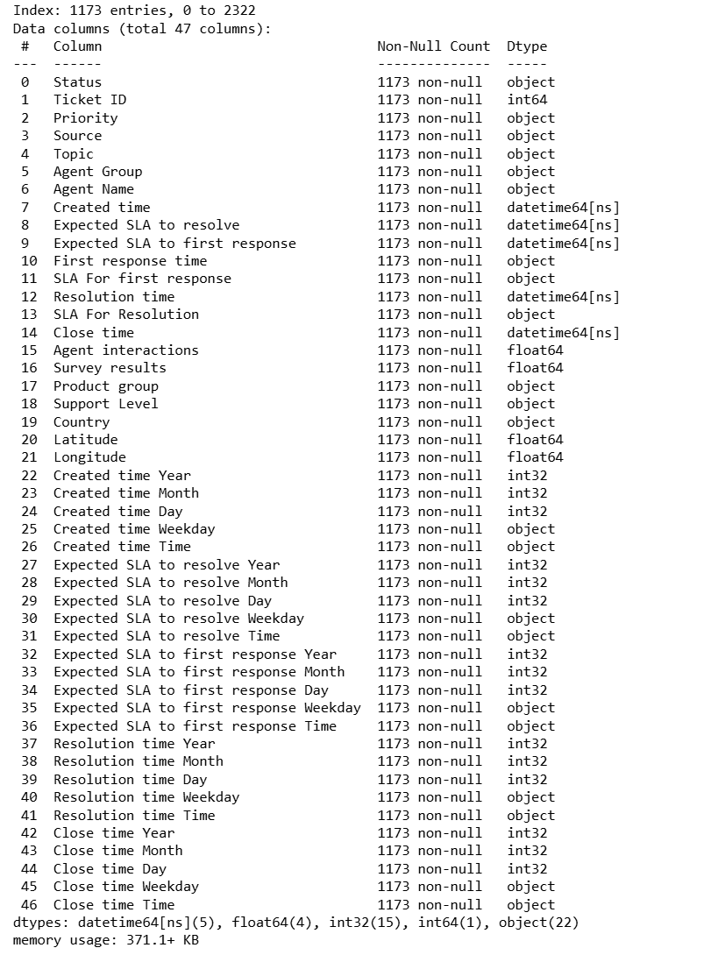
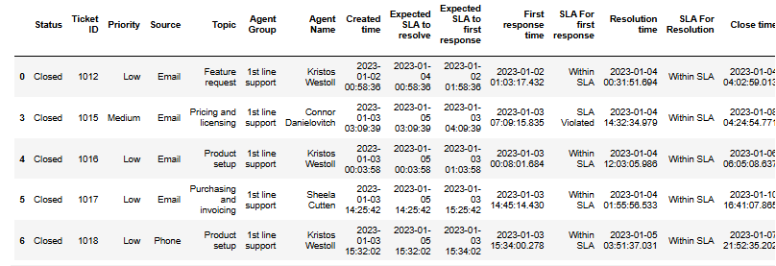
The Data
1173 lines with data
47 features
1-5 Survey Results
Satisfied / Dissatisfied
approach
Data Source: https://www.kaggle.com/datasets/suvroo/technical-support-dataset/discussion?sort=undefined
Notes:
Dataset was 88,000 rows and 100 columns
Measurements from 1909
250 total sites

Slide 5
Data Wrangling
Original dataset had 1173 rows
and 47 columns
Analyze data distribution
Analyze dependencies
Drop redundant columns
Target Variable: Survey results
Notes:
Wanted a large enough time span to capture multiple climate anomalies
Wanted to focus on sites actively being sampled
Reduced the size and scope considerably by dumping redundant data
Imputed values based on old measurements
Chose chlorphyll as my target vairable because it has far reaching and tangible, immediate effects on an ecosystem such as fish death and drops in dissolved oxygen

Slide 6
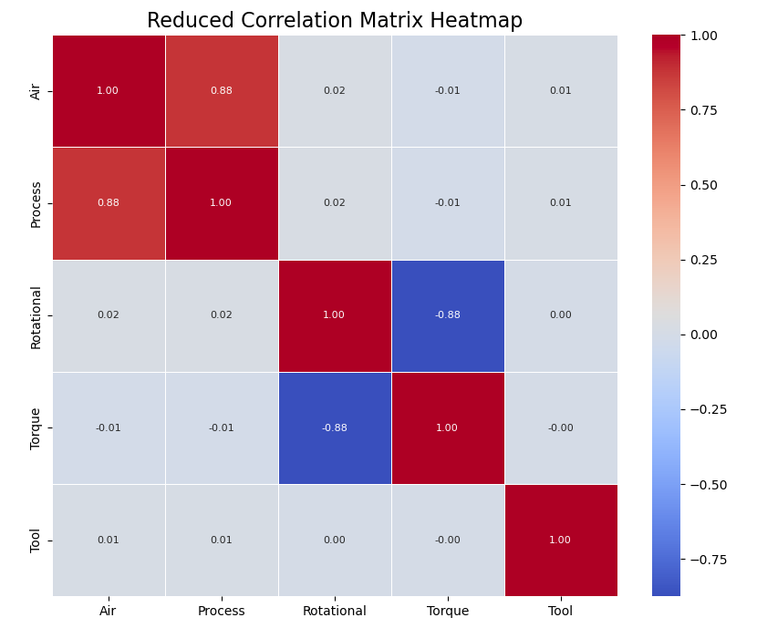
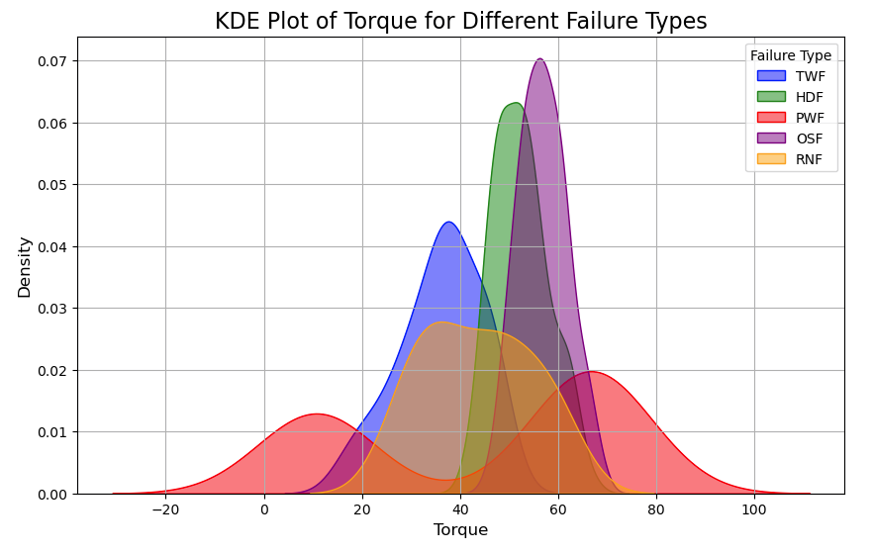
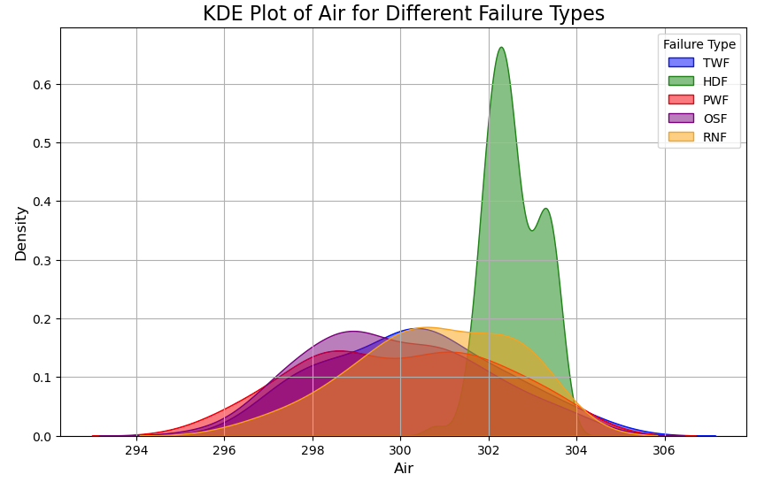
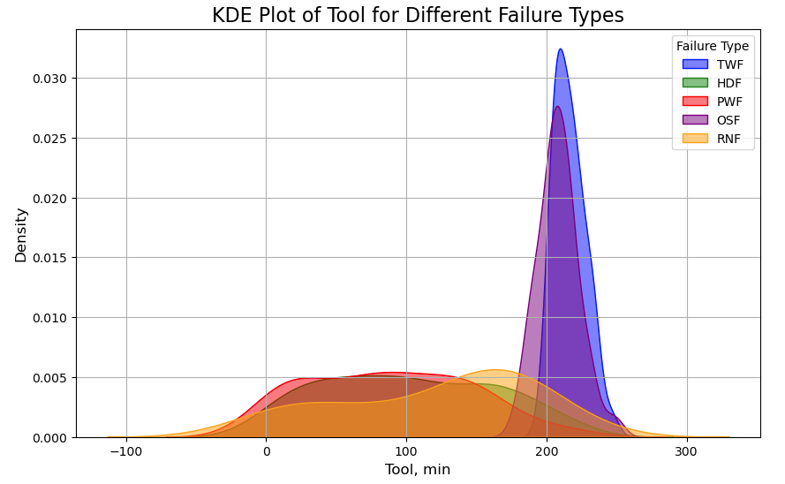
Exploratory Data Analysis
Notes:
Wanted a large enough time span to capture multiple climate anomalies
Wanted to focus on sites actively being sampled
Reduced the size and scope considerably by dumping redundant data
Imputed values based on old measurements
Chose chlorphyll as my target vairable because it has far reaching and tangible, immediate effects on an ecosystem such as fish death and drops in dissolved oxygen

Slide 7
Model Selection
Logistic Regression
Random Forest Classifier
DecisionTree

Slide 8
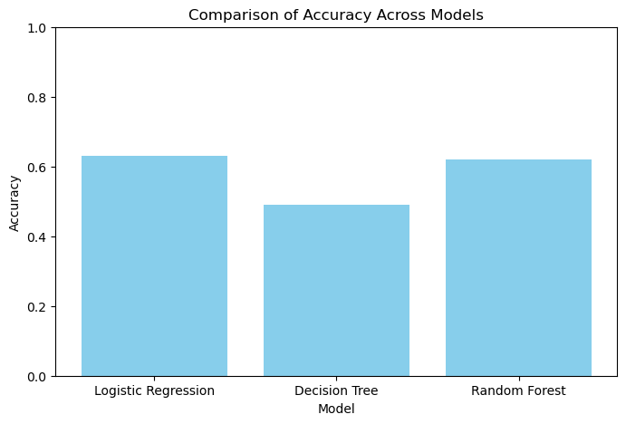
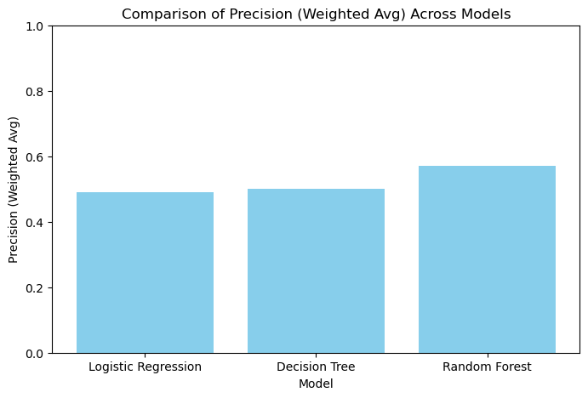


Models Comparison: Precision Recall
Logistic Regression
Accuracy: 63%
Precision (Weighted Avg): 0.49
Recall (Weighted Avg): 0.53
F1-Score (Weighted Avg): 0.49
Best Parameters: C=0.01,
penalty='l2’,
solver='lbfgs'
Decision Tree
Accuracy: 49%
Precision (Weighted Avg): 0.50
Recall (Weighted Avg): 0.49
F1-Score (Weighted Avg): 0.49
Best Parameters: criterion='entropy’,
max_depth=None,
min_samples_split=10,
min_samples_leaf=2
Random Forest
Accuracy: 62%
Precision (Weighted Avg): 0.57
Recall (Weighted Avg): 0.59
F1-Score (Weighted Avg): 0.57
Best Parameters: n_estimators=50,
criterion='gini’,
min_samples_split=10,
min_samples_leaf=5
Notes:
Here are the precision recall curves for two distinct sites.
The one on the left is one with good predicatability and the one on the right is one with poor.
I looked at 6 sites and found 3 with good predictability. Those are the ones that I developed models for.

Slide 9
Notes:
When tuning my parameters, I used Grid Search Cross Validation
The m

Slide 10
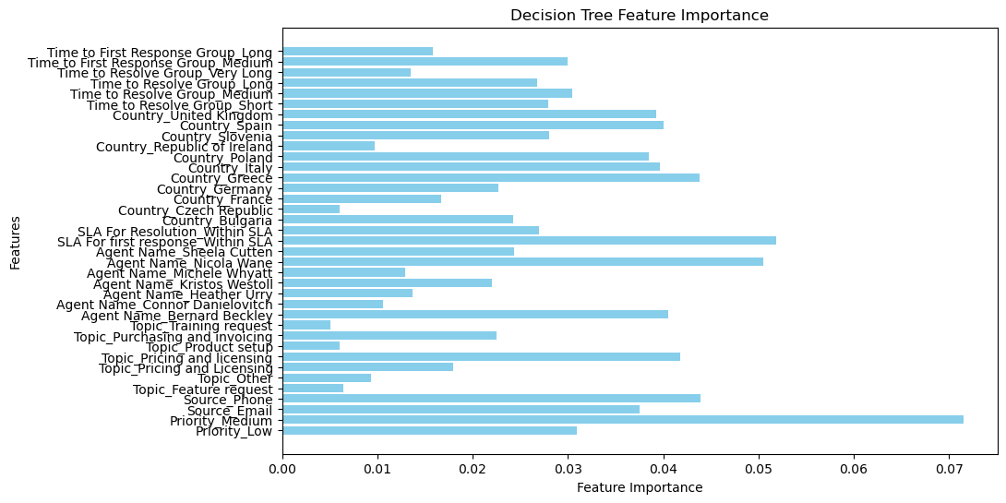
Feature Importance
Notes:
When tuning my parameters, I used Grid Search Cross Validation
The m

Slide 11
Summary
Best Recall:
Random Forest (0.59) achieved the highest overall performance metrics, making it the most suitable choice for this classification task
Recommendation
Increase n_estimators to 100 or 200 to improve model stability. Experiment with max_depth to further control overfitting.
Examine the importance of features to identify key drivers of the target variable.
Use class weighting or resampling methods to improve performance for the minority class
Consider using more advanced ensemble methods like Gradient Boosting (e.g., XGBoost, LightGBM) or hyperparameter optimization with RandomizedSearchCV or Bayesian Optimization.

Slide 12
Future Research
Conduct further feature engineering looking for stronger dependencies
Add probability of an event for each survey result outcome

Slide 13
Thank You!

Slide 14
Questions?

